Slide 1
Chapter 5 Ranking with Indexes
SEG301m

Slide 2
Objectives
How to rank a web, document
How to index a web, document

Slide 3
Contents
5.1 Abstract model of raking
5.2 Inverted Indexes
5.3 Compression
5.4 Axuiliary structures
5.5 Index construction
5.6 Query processing

Slide 4
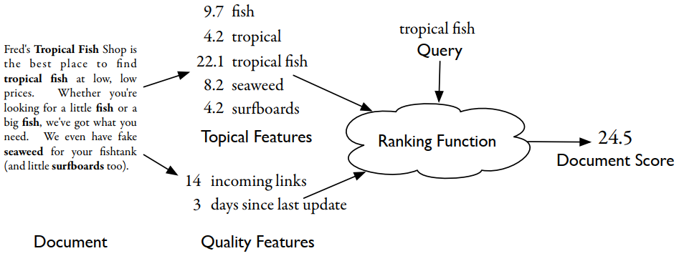
5.1 Abstract model of raking
The components of the abstract model of ranking: documents, features, queries, the retrieval function, and document scores

Slide 5
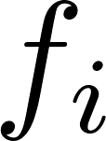
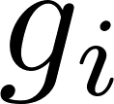
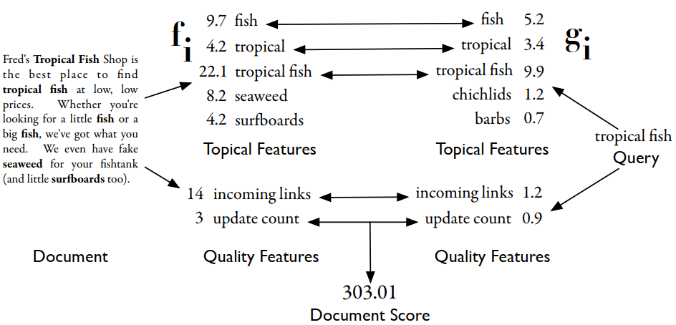
5.1 Abstract model of raking
Ranking function can be expressed as
where is feature function extracting a number from the document, while is feature function extracting a value from the query

Slide 6
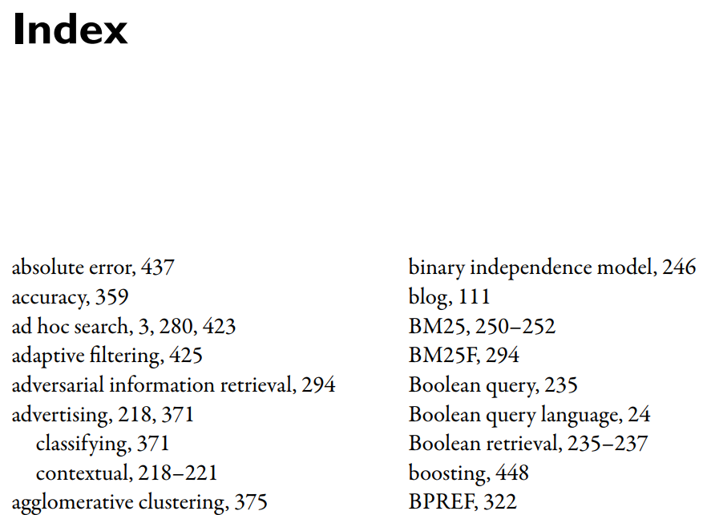
5.2 Inverted Indexes
Example: look for “adaptive filtering”
→ Go to “Index” and find the word starts with “a”
→ See “adaptive filtering”
→ See the pages that contain that words
Notes:
All modern search engine indexes are based on inverted indexes

Slide 7
5.2 Inverted Indexes
We think of words being a part of documents → inverted → documents are associated with words
Each index term has its own inverted list that holds the relevant data for that term
In an index for a book, the relevant data is a list of page numbers
In a search engine, the data might be a list of documents or a list of word occurrences

Slide 8
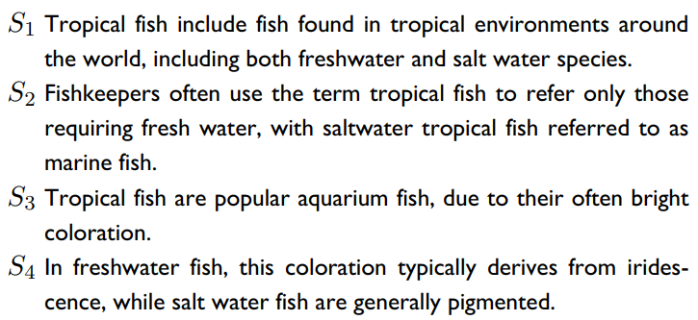
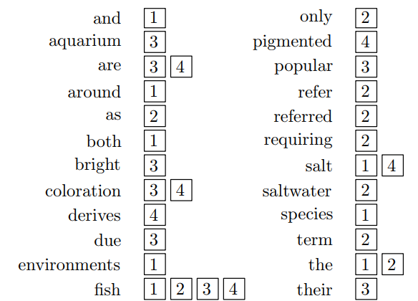
5.2 Inverted Indexes: Documents
Each one of these boxes is a posting
“fish” appears in all four sentences, because the numbers 1, 2, 3, and 4 appear by it

Slide 9
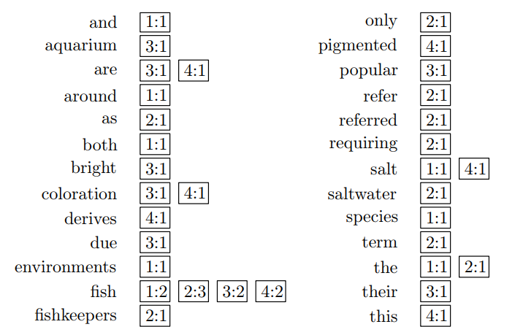
5.2 Inverted Indexes: counts
Each word in the index corresponds to a document feature

Slide 10
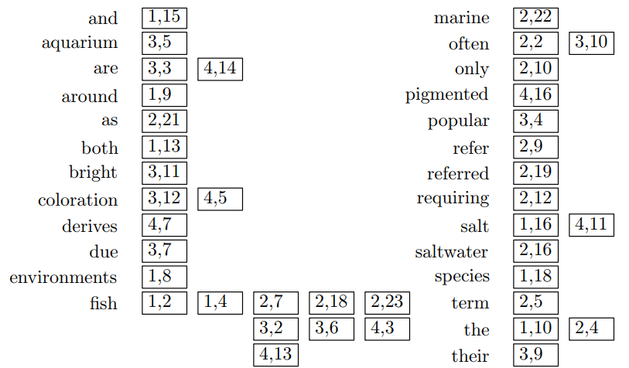
5.2 Inverted Indexes: positions
An inverted index, with word positions

Slide 11

5.2 Inverted Indexes: positions
Aligning posting lists for “tropical” and “fish” to find the phrase “tropical fish”
Notes:
Tis information is most interesting when we look at intersections with other posting lists. Using an intersection with the list for “tropical”, we fnd where the phrase “tropical fsh” occurs.

Slide 12
5.2 Inverted Indexes: fields and extents
Example: every email contains sender information and a subject line. All of these are instances of what we will call document fields, which are sections of documents that carry some kind of semantic meaning.
An extent is a contiguous region of a document
if the title of a book started on the fifth word and ended just before the ninth word we could encode that as (5,9)

Slide 13
5.2 Inverted Indexes: Scores
Whether should system store the value of the feature function?
It should store feature function values because it is too computationally intensive to compute during the query processing phase
Store the final value right in the inverted list
“fish” that has postings like [(1:3.6), (3:2.2)]: total feature value for “fish” in document 1 is 3.6, and in document 3 it is 2.2
How about the system’s flexibility?
Both increase and decrease
Notes:
It increases ﬂexibility because computationally expensive scoring becomes possible, since much of the hard work of scoring documents is moved into the index
ﬂexibility is lost, since we can no longer change the scoring mechanism once the index is built

Slide 14
5.2 Inverted Indexes: Ordering
Why does a system need an ordering score?
the query processing engine can focus only on the top part of each inverted list

Slide 15
5.3 Compression
Memory hierarchy?
The inverted lists for a large collection are themselves very large
Compression allows the same inverted list data to be stored in less space
Any disadvantage of compression?
processor can process p inverted list postings per second, a memory system that can supply the processor with m postings each second
The number of postings processed each second is then min(m, p)
What happens if p > m or p < m?
Notes:
the processor must decompress the data in order to use it : reduces space and is easy to decompress
compression is a useful performance technique only when the p > m, that is, when the processor can process inverted list data faster than the memory system can supply it

Slide 16
5.3 Compression
Introduce compression ratio r (processor read mr postings each second), decompress factor d (processor process dp postings each second)
Process min(mr, dp) postings each second

Slide 17
5.3 Compression: Entropy and Ambiguity
Consider the sequence: 0, 1, 0, 3, 0, 2, 0
Encoded by binary digits: 00 01 00 10 00 11 00
Encoding 0 using just a single 0 bit: 0 01 0 10 0 11 0
What’s wrong?

Slide 18
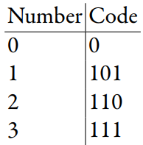
5.3 Compression: Entropy and Ambiguity
Use prefix codes and prefix-fee codes to avoid ambiguity
The result: 0 101 0 111 0 110 0 (13 bits)
Entropy measures the predictability of the input

Slide 19
5.3 Compression: Delta Encoding
Consider the sequence: 1, 5, 9, 18, 23, 24, 30, 44, 45, 48
The encoding sequence: 1, 4, 4, 9, 5, 1, 6, 14, 1, 3

Slide 20
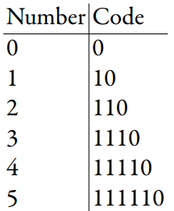
5.3 Compression: Bit-Aligned Codes
Uses a single symbol to encode numbers

Slide 21
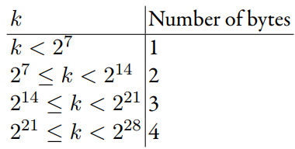
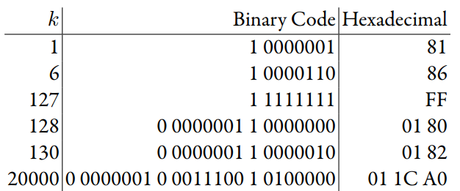
5.3 Compression: Byte-Aligned Codes
Sample encodings for v-byte (variable byte length)
Space requirements for numbers encoded in v-byte

Slide 22
5.3 Compression: In practice
New compression schemes are developed every year.
Why are these new schemes necessary?
Compression algorithm is tightly coupled with the state of modern CPUs and memory systems
Now: are lower compression ratios attractive?

Slide 23
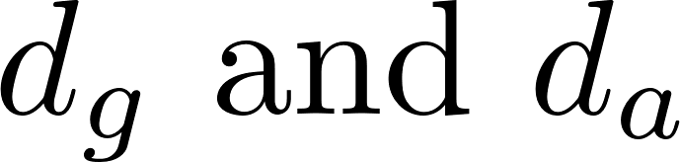
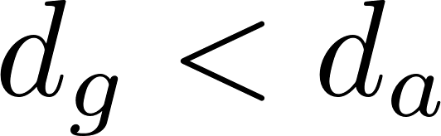
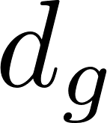
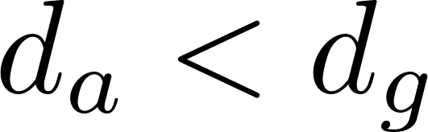

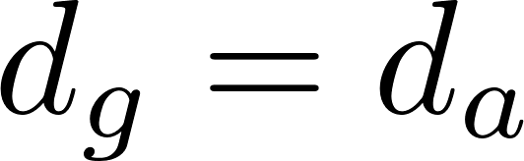

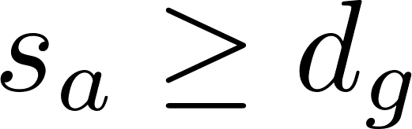
5.3 Compression: Skipping and Skip Pointers
Consider the Boolean query “galago AND animal”.
Let be the first document number in the inverted list for “galago.” and “animal.” respectively
While there are still documents in the lists for “galago” and “animal,” loop:
If , set to the next document number in the “galago” list
If , set to the next document number in the “animal” list.
If , the document contains both “galago” and “animal”. Move both and to the next documents in the inverted lists for “galago” and “animal,” respectively
Skip ahead k documents to a new document . Repeat until → narrow down to k documents

Slide 24
5.4 Auxiliary Structures
Vocabulary and statistics
Documents, snippets, and external systems

Slide 25
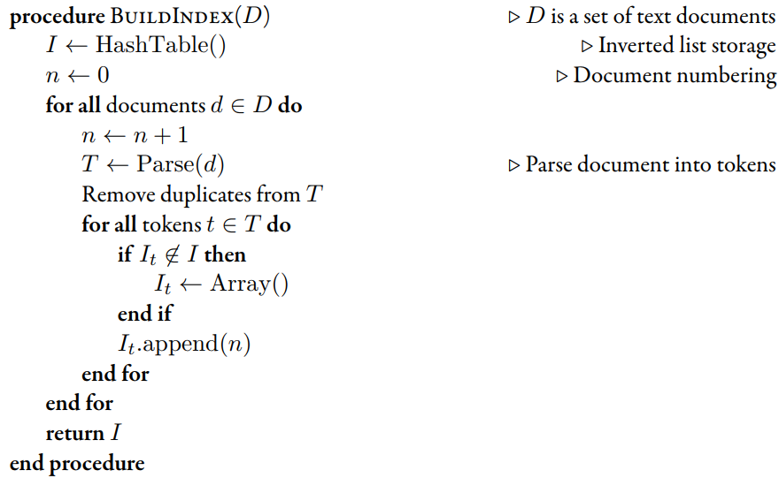
5.6 Index construction: simple construction
Pseudocode for a simple indexer

Slide 26
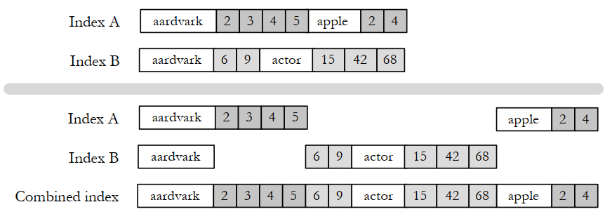
5.6 Index construction: merging
An example of index merging. The first and second indexes are merged together to produce the combined index

Slide 27
5.6 Index construction: parallelism and distribution
Use many inexpensive servers together and use distributed processing software to coordinate the activities of search engine
the amount of data to index in the largest systems is exploding
simple economics
RPC, CORBA, Java RMI, and SOAP have been developed to allow function calls across machine boundaries

Slide 28
5.6 Index construction: parallelism and distribution
Data placement: decides whether data processing is efficient
Example: Suppose you have a text file that contains data about credit card transactions. Each line of the file contains a credit card number and an amount of money. How might you determine the number of unique credit card numbers in the file?
Many files in one computer?
Many files in many computers?
Easiest way?

Slide 29
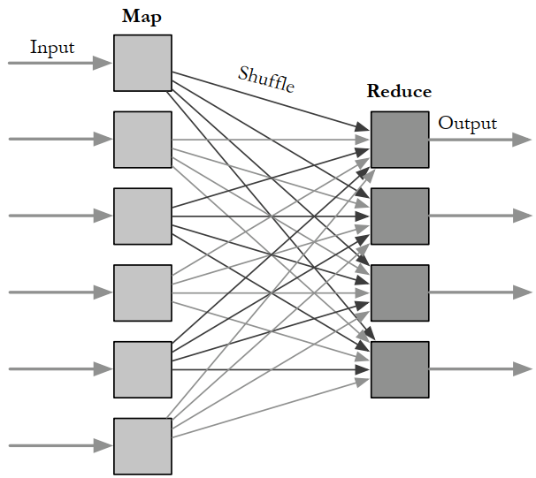
5.6 Index construction: parallelism and distribution
The MapReduce library automatically launches many Mapper and Reducer tasks on a cluster of machines

Slide 30
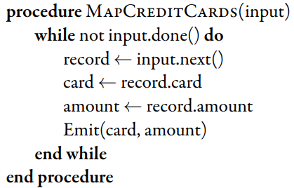
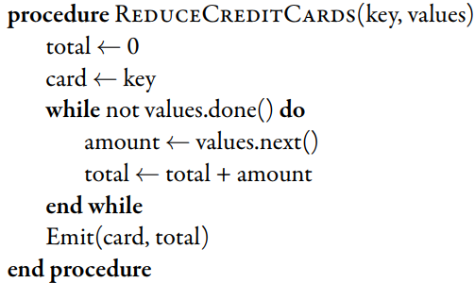
5.6 Index construction: parallelism and distribution
Mapper and Reducer tasks

Slide 31
5.6 Index construction: update
Most interesting document collections are constantly changing
Collections tend to get bigger over time
The contents of documents can change over time
Two techniques to solve the problem of update
Index merging
Result merging
Notes:
Index merging is a reasonable update strategy when index updates come in large batches, perhaps many thousands of documents at a time.
Result merging solves the problem of how to handle new documents: just put them in a new index.

Slide 32
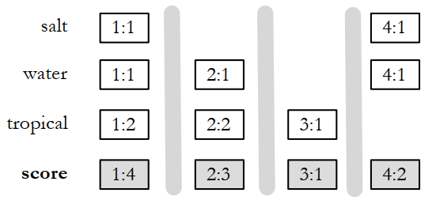
5.7 Query Processing: Document-at-a-time evaluation
The simplest way, at least conceptually, to perform retrieval with an inverted file.
Document-at-a-time query evaluation. The numbers (x:y) represent a document number (x) and a word count (y)

Slide 33
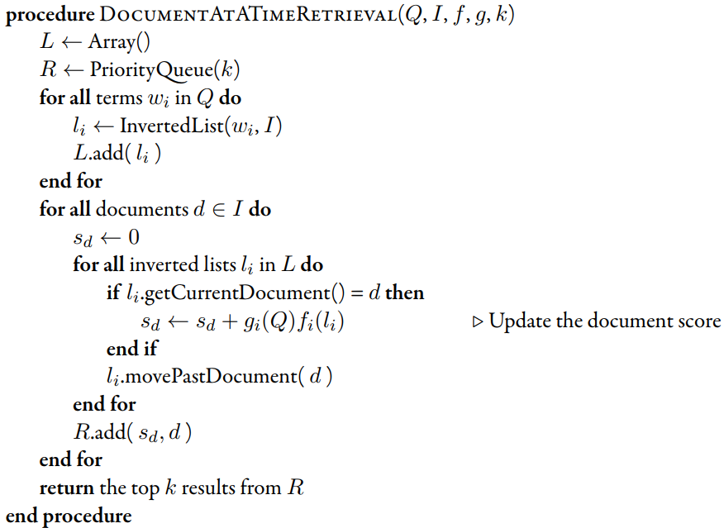
5.7 Query Processing: Document-at-a-time evaluation
A simple document-at-a-time retrieval algorithm

Slide 34
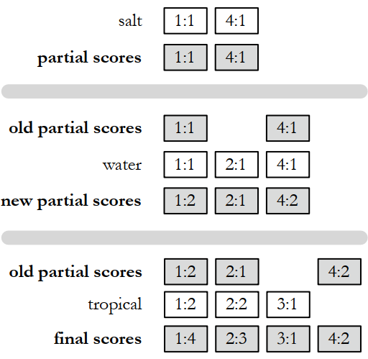
5.7 Query Processing: Term-at-a-time evaluation
Term-at-a-time evaluation

Slide 35
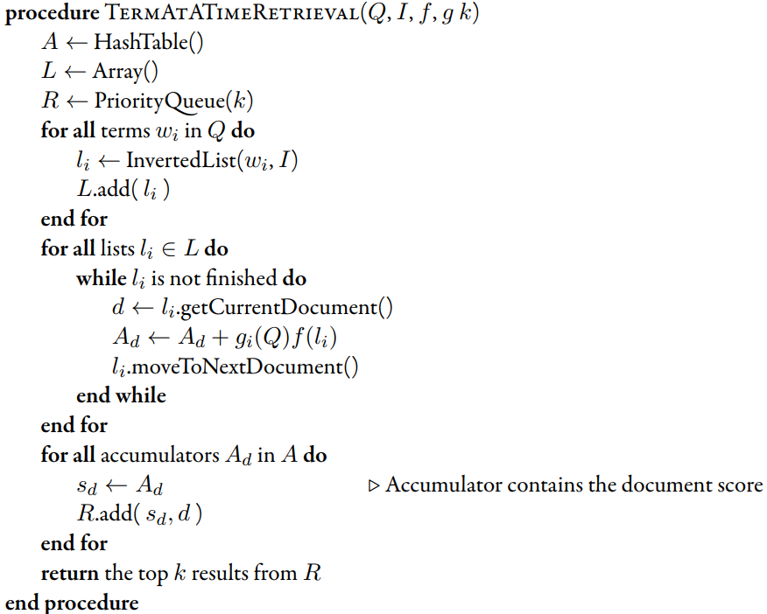
5.7 Query Processing: Term-at-a-time evaluation
A simple term-at-a-time retrieval algorithm

Slide 36
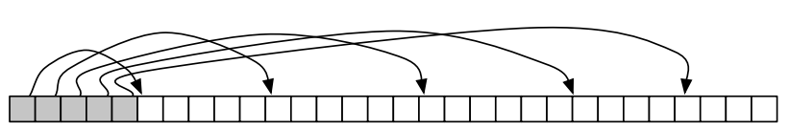
5.7 Query Processing: Optimization techniques
List skipping
Skip pointers in an inverted list. The gray boxes show skip pointers, which point into the white boxes, which are inverted list postings

Slide 37
5.7 Query Processing: Optimization techniques
Conjunctive processing
Conjunctive processing works best when one of the query terms is rare
Conjunctive processing can be employed with both term-at-a-time and document-at-a-time systems

Slide 38
5.7 Query Processing: Optimization techniques
Threshold methods
k is the number of results requested by the user: usually from 10 to 20

Slide 39
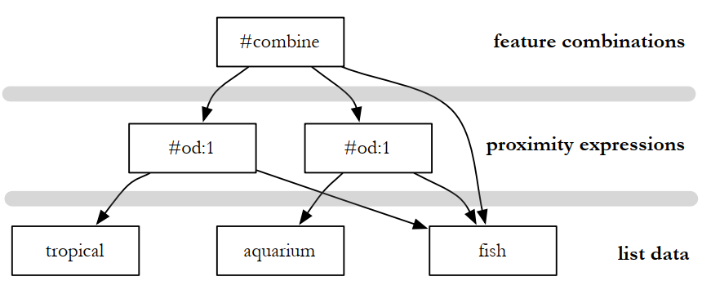
5.7 Query Processing: Structured queries
Evaluation tree for the structured query #combine(#od:1(tropical fish) #od:1(aquarium fish) fish)

Slide 40
5.7 Query Processing: Distributed evaluation
Document distribution
Each index server acts as a search engine for a small fraction of the total document collection
Term distribution
A single index is built for the whole cluster of machines. Each inverted list in that index is then assigned to one index server.

Slide 41
5.7 Query Processing: caching
Broadly speaking, caching means storing something you might want to use later
Broadly speaking, caching means storing something you might want to use later
Processing a query against a large corpus can be very computationally intensive → keep it around.

Slide 42
Exercise
Given two documents:
Document 1: Football is a family of team sports that involve, to varying degrees, kicking a ball to score a goal.
Document 2: A football team is a group of players selected to play together in the various team sports known as football.
Implement the algorithm generating the inverted index, write an algorithm that locates all “sports” term.

Slide 43
Summary
Abstract model of raking
Inverted indexed, compression
Query processing techniques and evaluation

